Slide 1
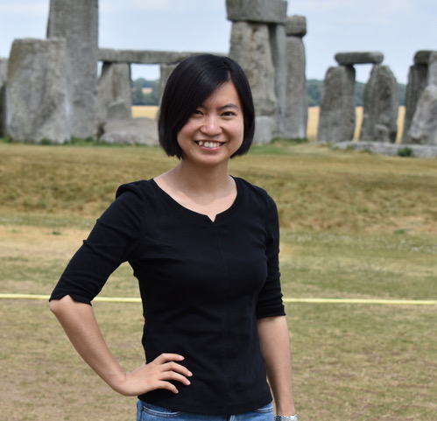
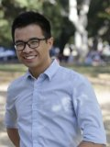
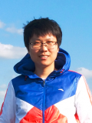
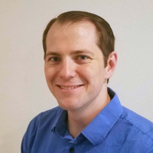
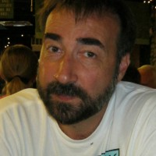
EcoSLIM
Princeton GPU Hackathon 2021
Jun Zhang Hoang Tran Chen Yang
U of Arizona Princeton U Princeton U
Troy Comi Carl Ponder
Princeton U NVIDIA

Slide 2
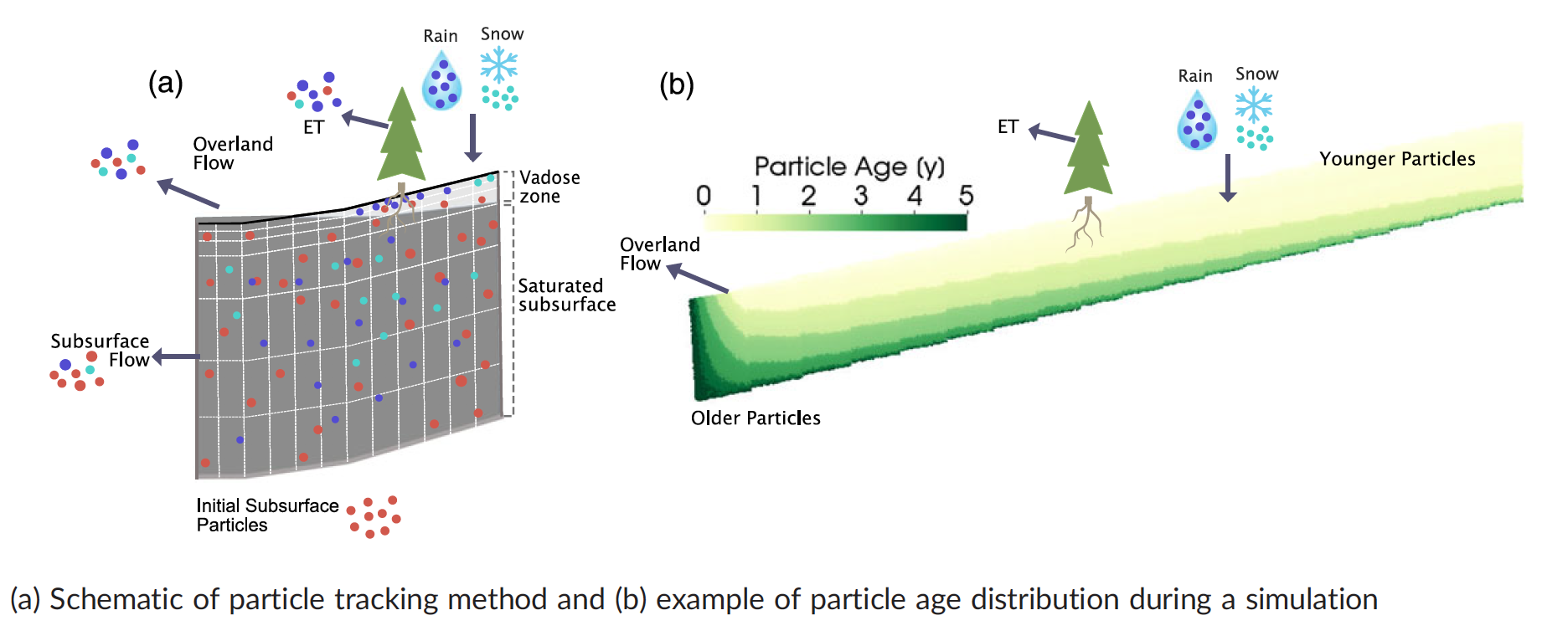
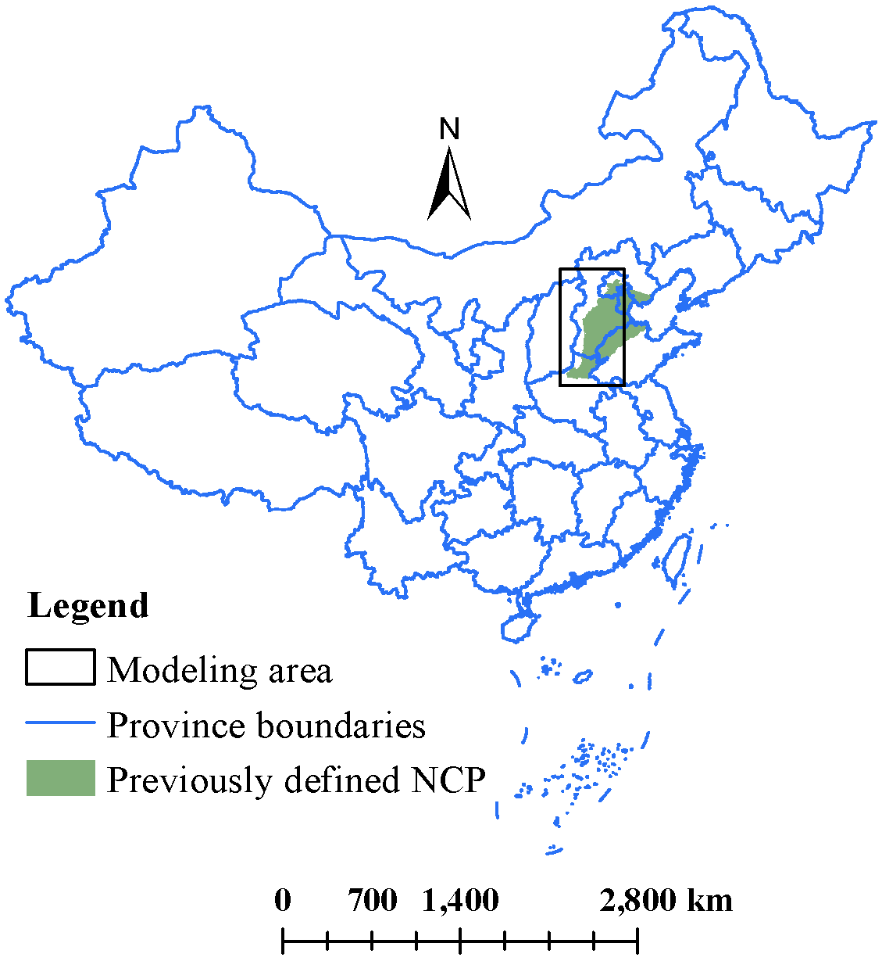
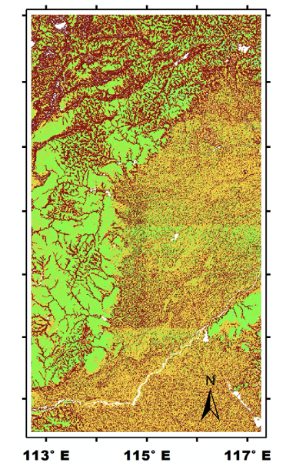
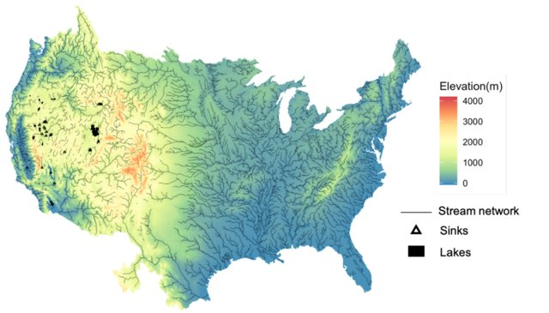
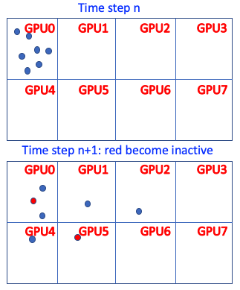
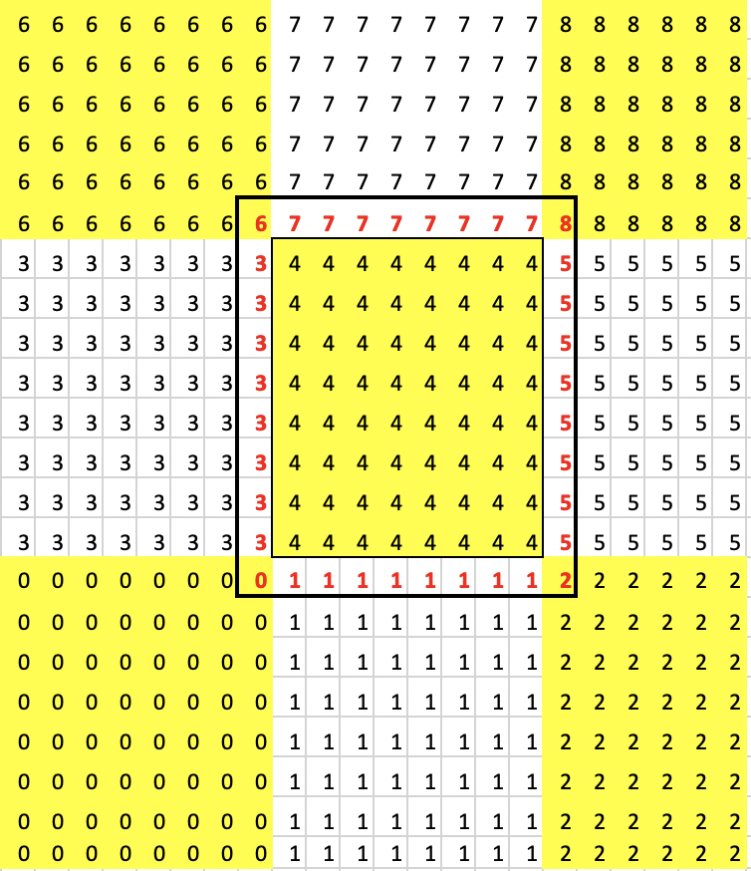
EcoSLIM
A Lagrangian particle tracking code
calculating water ages and source water mixing
What was your goal coming here?
Initial strategy? How did this strategy change?
GPU8
Multi-GPU with MPI
Fortran/CUDA-Fortran
GPU0

Slide 3
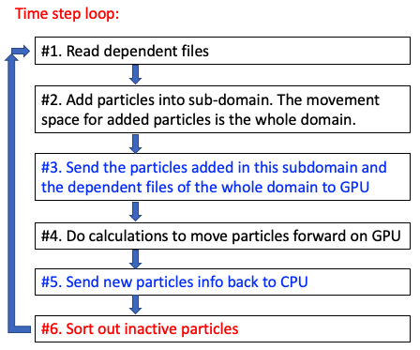
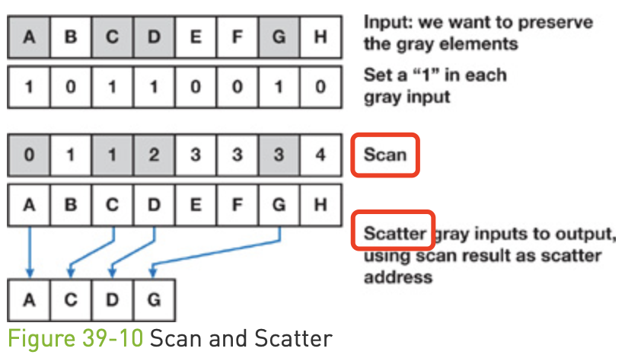
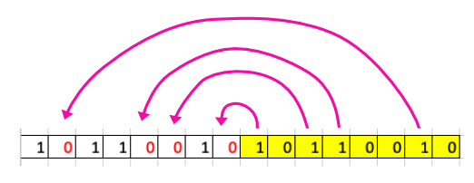
What we focus on?
Stream compaction based on prefix sum
1D array to 2D array
In-place compaction
New in-place compaction

Slide 4
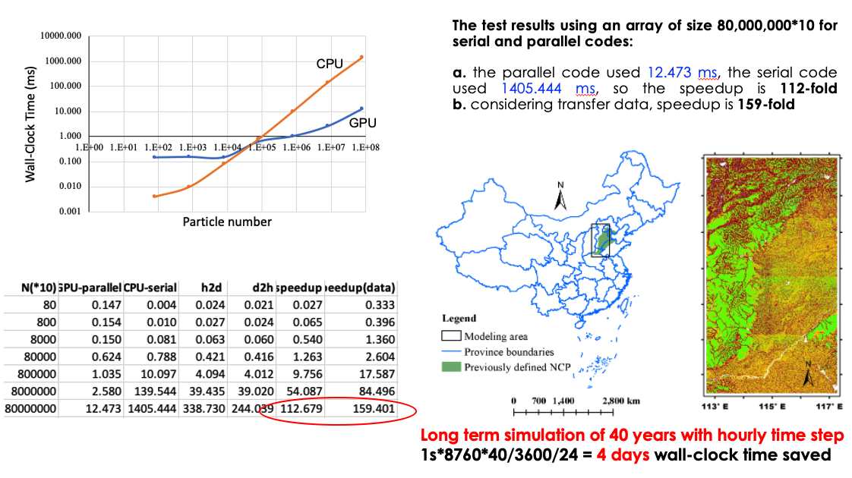
Results

Slide 5
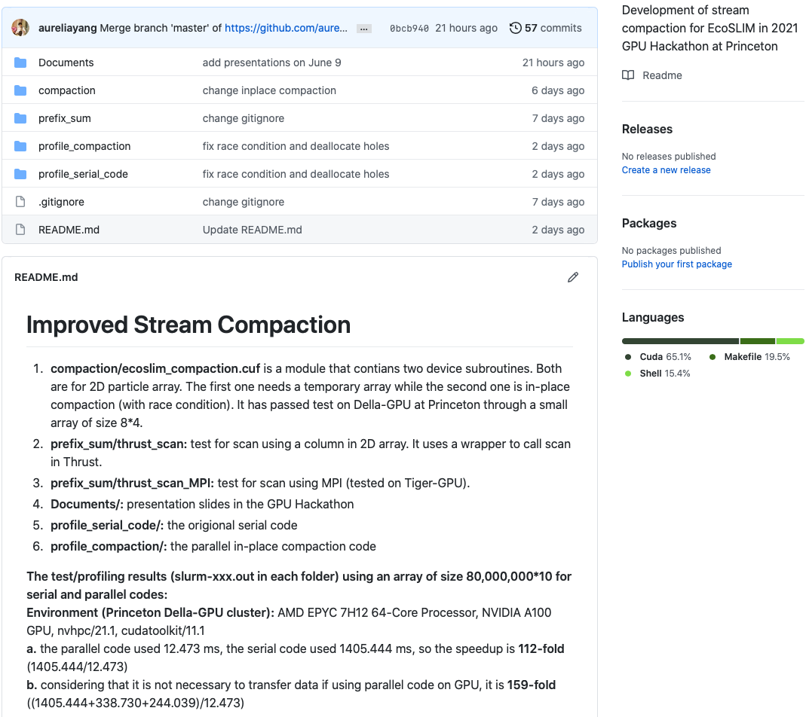
Outcome on Github
https://github.com/aureliayang/EcoSLIM_Compaction

Slide 6
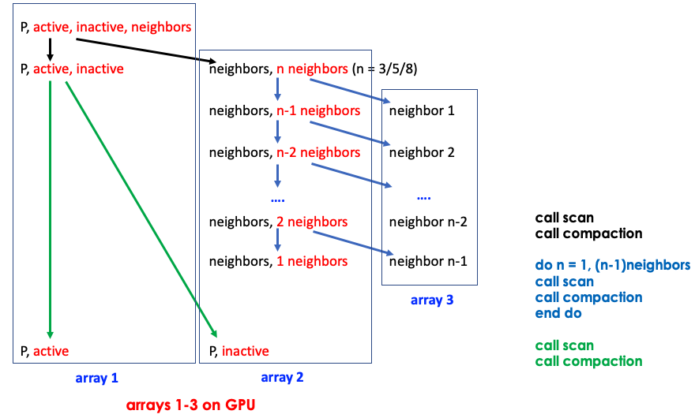
Applications of compaction

Slide 7
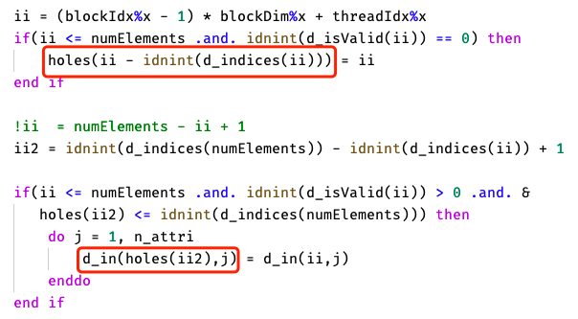
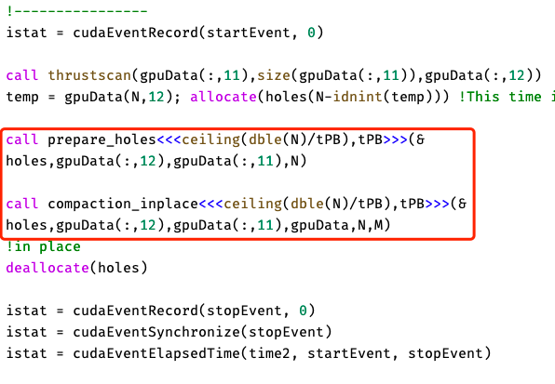
What problems you encountered
Race condition
build holes
fill holes
Holes: the locations of zeros

Slide 8
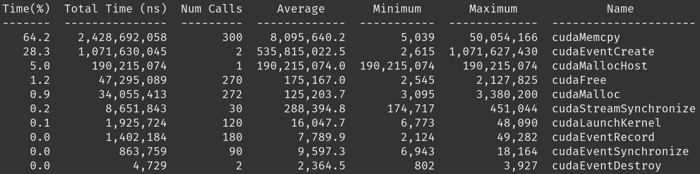
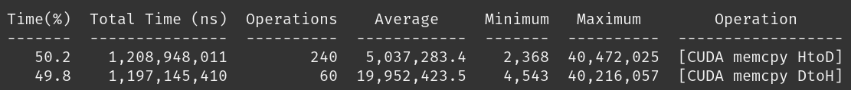
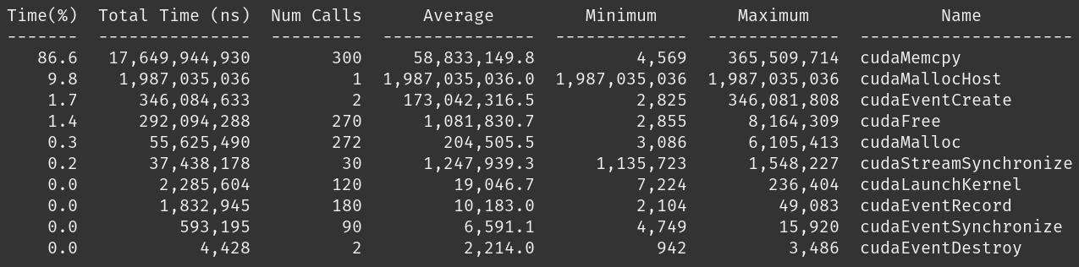
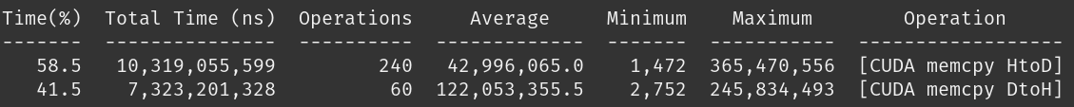
What did you learn?
NVIDA Nsight: profiling our stream compaction results
8x10⁶
8x10⁷
Notes:
NVIDIA® Nsight™ Systems is a system-wide performance analysis tool designed to visualize an application’s algorithms, help you identify the largest opportunities to optimize, and tune to scale efficiently across any quantity or size of CPUs and GPUs; from large server to our smallest SoC.
When increase the number of particle 10 times, copy time from Host to drive and memory time increased proportionally, others are not → change in the time distribution propotion

Slide 9
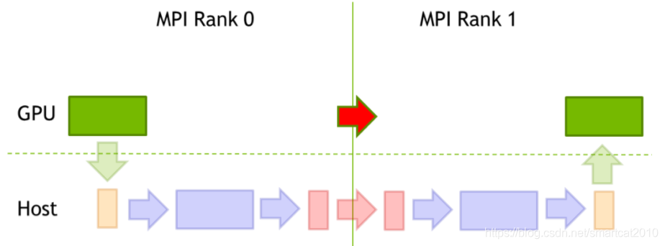
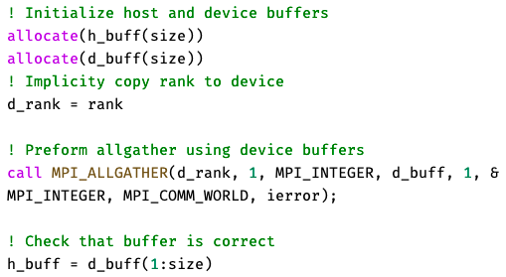
What did you learn?
CUDA-Aware MPI
Notes:
Calculate particle transfer on GPU without copying back and fort with CPU

Slide 10
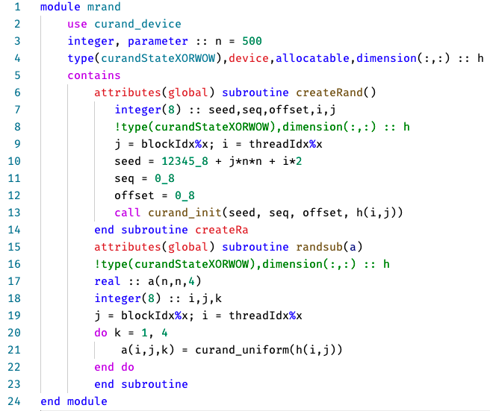
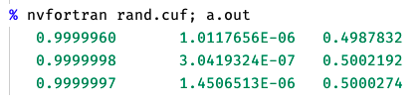
What did you learn?
Generate random numbers using Device API of cuRAND

Slide 11
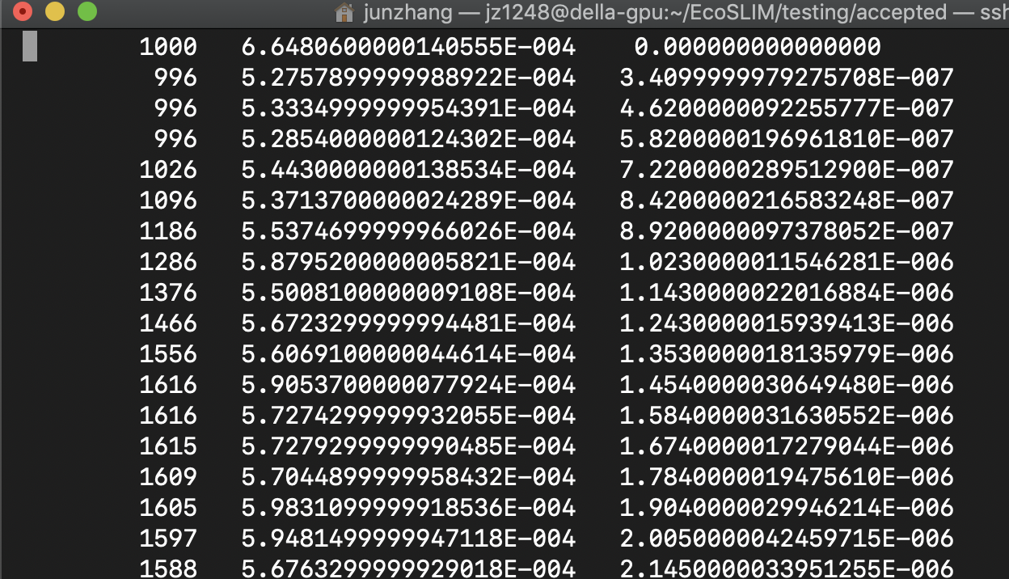
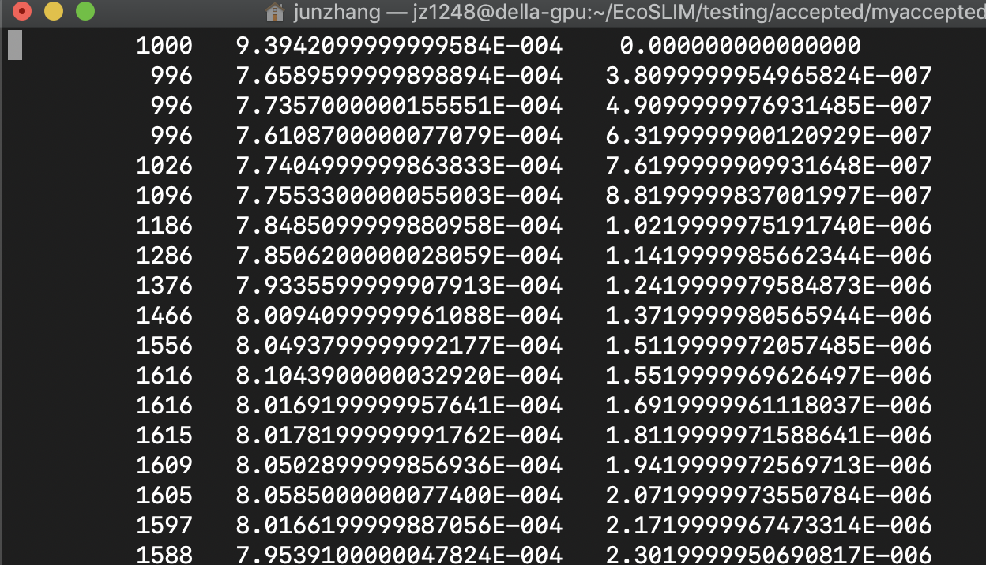



What did you learn?
Refactor code with cmake
Previous accepted results
Results from cmake test

Slide 12
Wishlist and next step
What do you wish existed to make your life easier?
Tools
Language standards
Event
Systems
Go on the development of EcoSLIM to handle the continental US scale

Slide 13
Acknowledgements
Thanks to Julia and Gabe, and other organizers!
Thanks to every awesome attendee!
Thanks to Carl and Troy!
Thanks to our members!

